Slide 1
Religious Figures
Reach for the Top
Evan Sauve

Slide 2
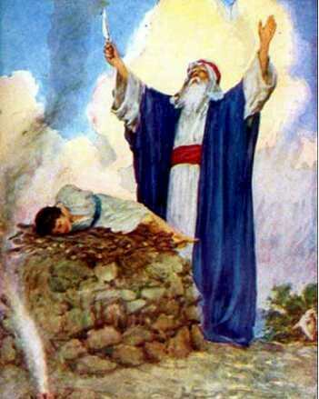
Abraham
I am thought to have been born around 2100 BC, in the city of Ur.
I was one of the first people to believe in a monotheistic (a single god) philosophy.
I had two sons: Isaac and Ishmael, from whom Jewish and Arab people trace their origins.
I am a biblical figure, and in the earliest citations, I am known as Abram.

Slide 3
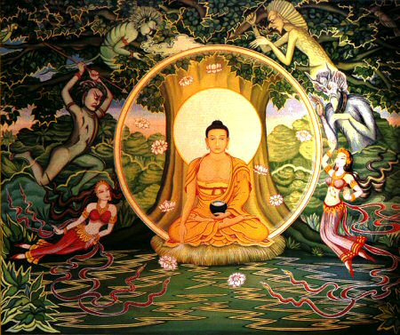
Gautama Buddha
I was born in 563 BC, in India.
My father confined me to a palace, with a life of luxury and ease. Eventually, I sneaked out of the palace.
I found a sick person, a geriatric and a corpse. Upon this, I became determined to find an end to suffering.
Neuroscientists are confirming that my teachings of mindfulness meditation are accurate about the inner workings of the mind.

Slide 4
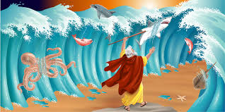
Moses
I am most influential in Judaism, but I am also well-known in Christianity and Islam.
In Biblical narratives, I am associated with the Hebrew Tribes in Canaan.
After wandering 40 years through the desert, I died within sight of the Promise Land.
Atop Mount Sinai, I received the Ten Commandments.

Slide 5
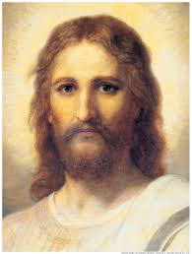
Jesus of Nazareth
I am a Jewish lecturer, born in 5 BC.
My teachings included radical ideas such as “do unto others as you would have them do unto you.” With disciples, I was able to spread my philosophies. I did not write anything. My enemies were the devoutly religious Jews of my time.
I am thought to have been born in Bethlehem under Roman rule, perhaps only lived about 33 years and I am portrayed in countless paintings done centuries after my execution by people who never met me.
I am a descendent of Abraham, Isaac and David, my life is the premise of the New Testament and many refer to me as the son of God.

Slide 6
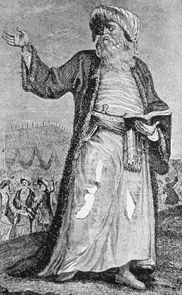
Muhammad
I was born about 600 years after Jesus’ death. Like Jesus, I am a descendent of Abraham and I preached beliefs of a religion that is still popular today.
Unlike Jesus, I was a descendent of Abraham’s son Ishmael.
I often contemplated and questioned beliefs of my age, and prayed in a cave just outside of Mecca.
In this cave, an angel offered me the Koran, the word of Allah, and charged me to “Proclaim”. This was the beginning of Islamic faith.

Slide 7
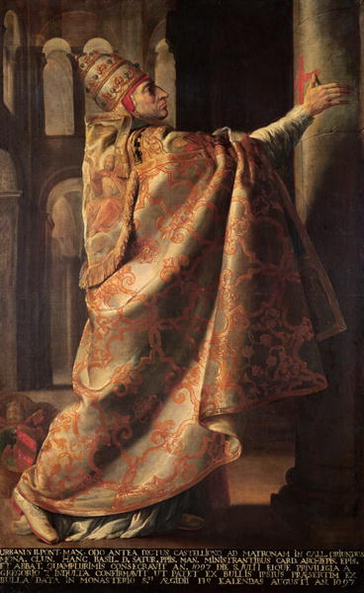
Pope Urban II
In 1095, I convened a council after Byzantine emperor Alexius I Comnenus approached me for support.
I gave an effective sermon to bishops from across Europe. There are five versions of this speech.
Although these versions differ for the most part, they agree that I spoke of the violence in Europe, the willingness to help the Greeks, the righteousness of pilgrimage and the blessings for those who joined the fight.
This speech led to the first bloody Crusade, the retaking of Jerusalem being accomplished on July 15th, 1099. I died two weeks later, before the news had traveled to me.

Slide 8
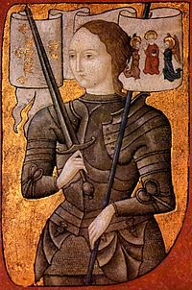
Joan of Arc
I was born in 1412 and I had a short life, ending in 1431.
Today I am considered a saint.
I am called the “Maid of Orleans.”
As a child, I apparently heard voices in my head. I claimed these voices were of Saint Michael, Saint Catherine and Saint Margaret. I was burned to death for heresy after leading children into battle.
In 1920, I was canonised by the Roman Catholic Church, and today many French (and others) celebrated my feast day on May 30th.

Slide 9
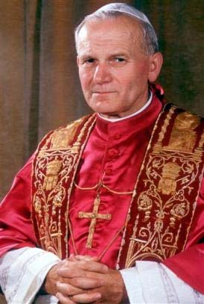
Pope John Paul II
I was born the year Joan of Arc was canonised. I later became a pope.
Non-Catholic preacher Billy Graham said about me, “Few individuals have had a greater impact – not just religiously but socially and morally – on the modern world.”
Although my name at birth was Karol Wojtyla, you probably know me by a three-part name, two names and a number.
I traveled more miles than all previous popes combined. My names are two of the Beatles, and my number is how many Beatles are still alive.

